Slide 1
AWS elb
Abilash s r

Slide 2
what is load balancer?
A load balancer acts as the “traffic cop” sitting in front of your servers and routing client requests across all servers capable of fulfilling those requests
Modern high‑traffic websites must serve hundreds of thousands, if not millions, of concurrent requests from users or clients and return the correct text, images, video, or application data, all in a fast and reliable manner.
Receiving and then distributing incoming requests to any available server capable of fulfilling them. And ensures that no one is overworked.

Slide 3
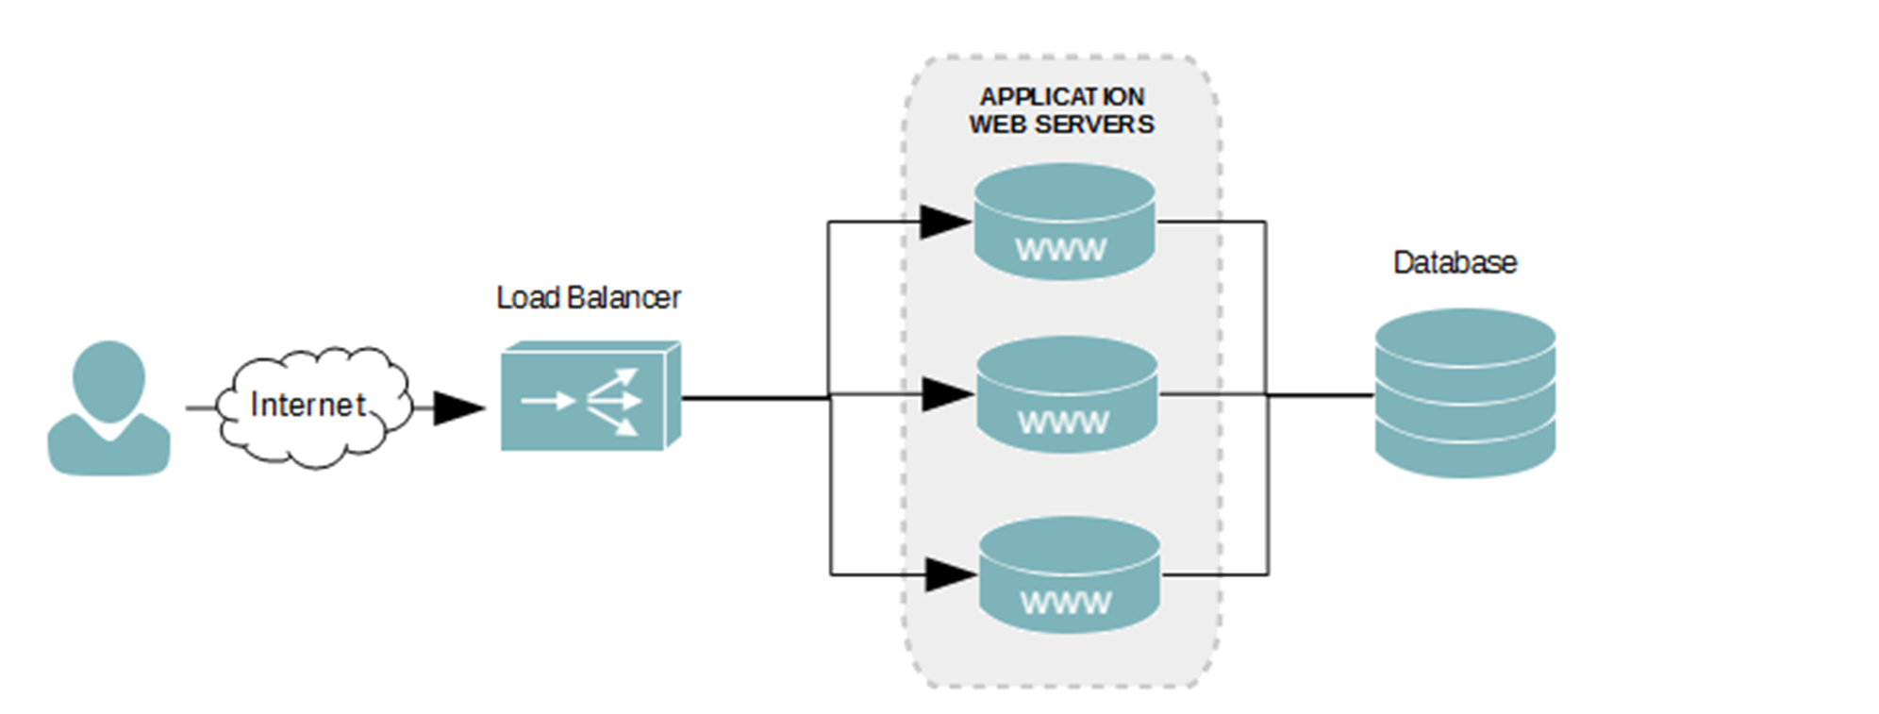
How LB Works?

Slide 4
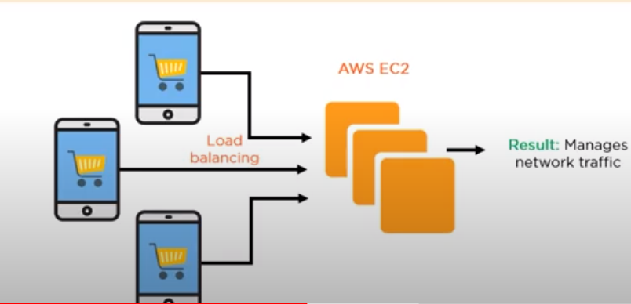
How FLIPKART,AMAZON works on big billon days?

Slide 5
Types of lb ALGORITHM ?
Round Robin
Least Connections
IP Hash
AWS used Least outstanding requests (LOR) algorithm, addition to the round-robin algorithm

Slide 6
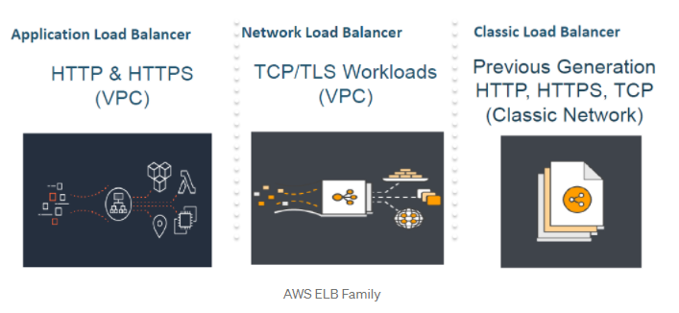
TYPES OF AWS lb **Gateway LB NEW**

